Slide 1

HOW TO MAKE TECHNICAL DECISIONS?

Slide 2
Examples
Docker swarm
Kubernetes
Graphite
Prometheus
MongoDB
MySQL
implement
reuse

Slide 3
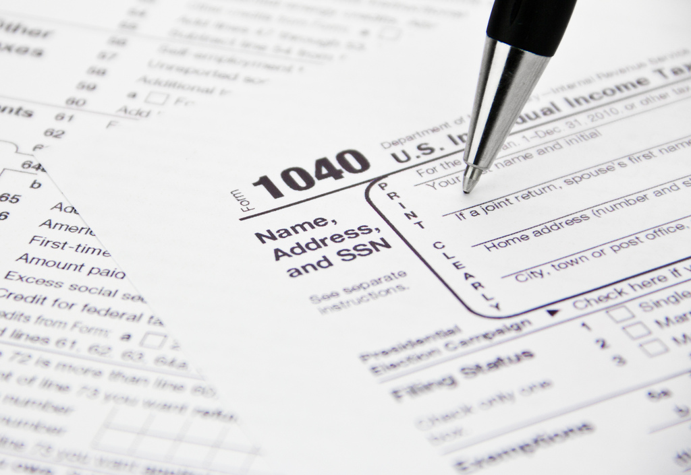
your WORST technical decision here

Slide 4
… let me help
own persistency layer
in PHP
2
non-compatible components
~ 300 dependencies each

Slide 5

We all have war stories
implement own
Serverless runtime
&
use it in the project

Slide 6
COST OF A BAD DECISION

Slide 7




STICKY
COGNITIVE NOISE
TECHNICAL DEBT
ACCIDENTAL COMPLEXITY
Notes:
Cognitive Noise OWN STORY: 3 syntactic sugar libraries for same purpose (commons, guava)
(PAUSE)

Slide 8


Slide 9

SOLVES THE RIGHT PROBLEM

Slide 10
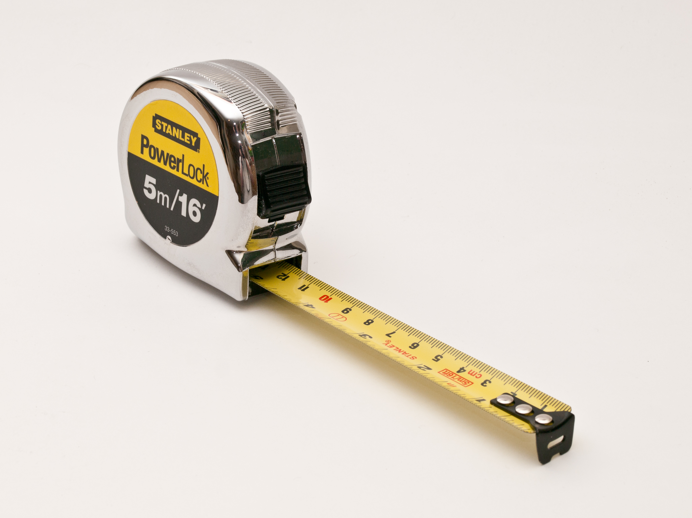
METRICS
Notes:
POLL!!!

Slide 11
What metrics would you use to aid your technical decisions? (11)
Roi
Class fan out compl.
time
What's the effort (dev-tim) required to revert it or use something else
Number of pros vs cons, feedback from communities/ppl.
Tech debts introduced (in days) / time to implement
added transitive dependencies
Size of community supporting that stuff
number of successful projects using the same technology
Commit rate
Maturity
Performance degradation
NPath complexity

Slide 12




EASY TO USE
MAINTAINABLE
FAST
NO SURPRISES

Slide 13
Learning
Curve
Design
Runtime

Slide 14
API
maturity
Design
simplicity
feature
richness
interfacing
(replaceable)

Slide 15
quality
docs
usability
Learning
Curve
fast feedback
team expertise

Slide 16
feature richness
technical constraints
no SPOF
stability
performance
Runtime
debugging
logging
quality
of
feedback
monitoring
exceptions

Slide 17
API
maturity
quality
docs
usability
technical constraints
Design
simplicity
Learning
Curve
interfacing
(replaceable)
feature
richness
fast feedback
team expertise
stability
debugging
Runtime
no SPOF
logging
quality
of
feedback
exceptions
performance
monitoring

Slide 18
HOW TO MEASURE?

Slide 19
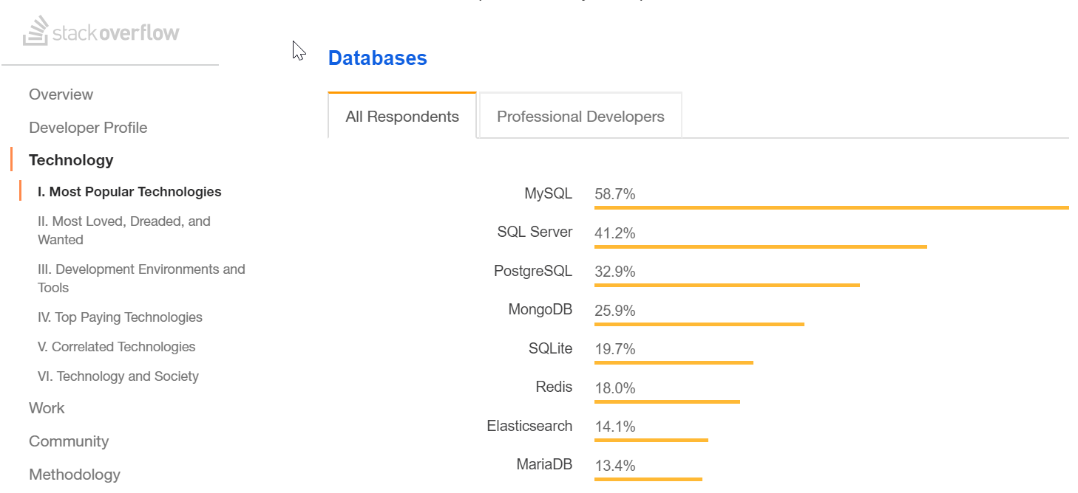
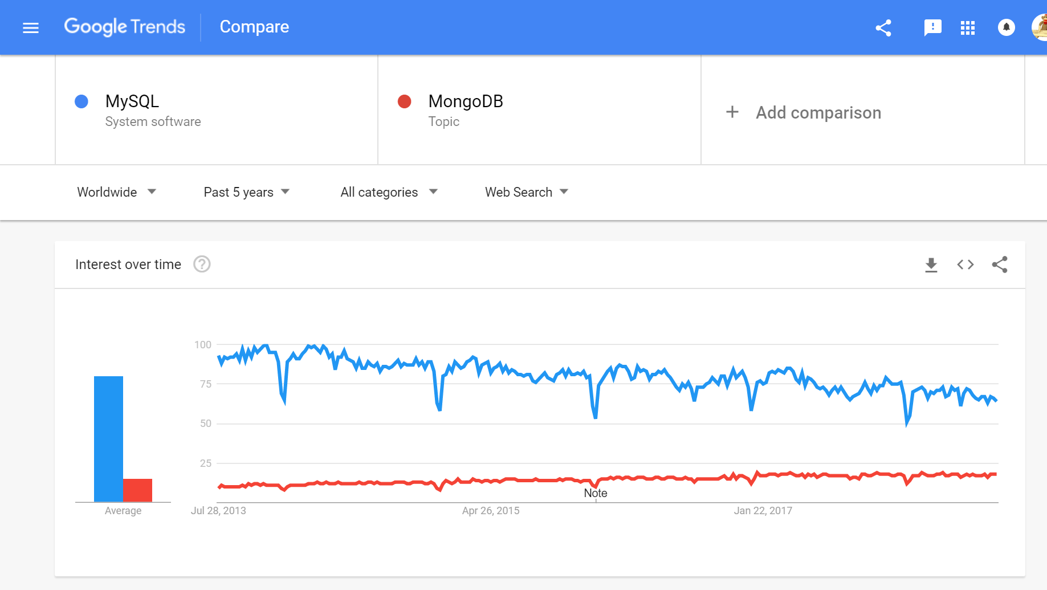
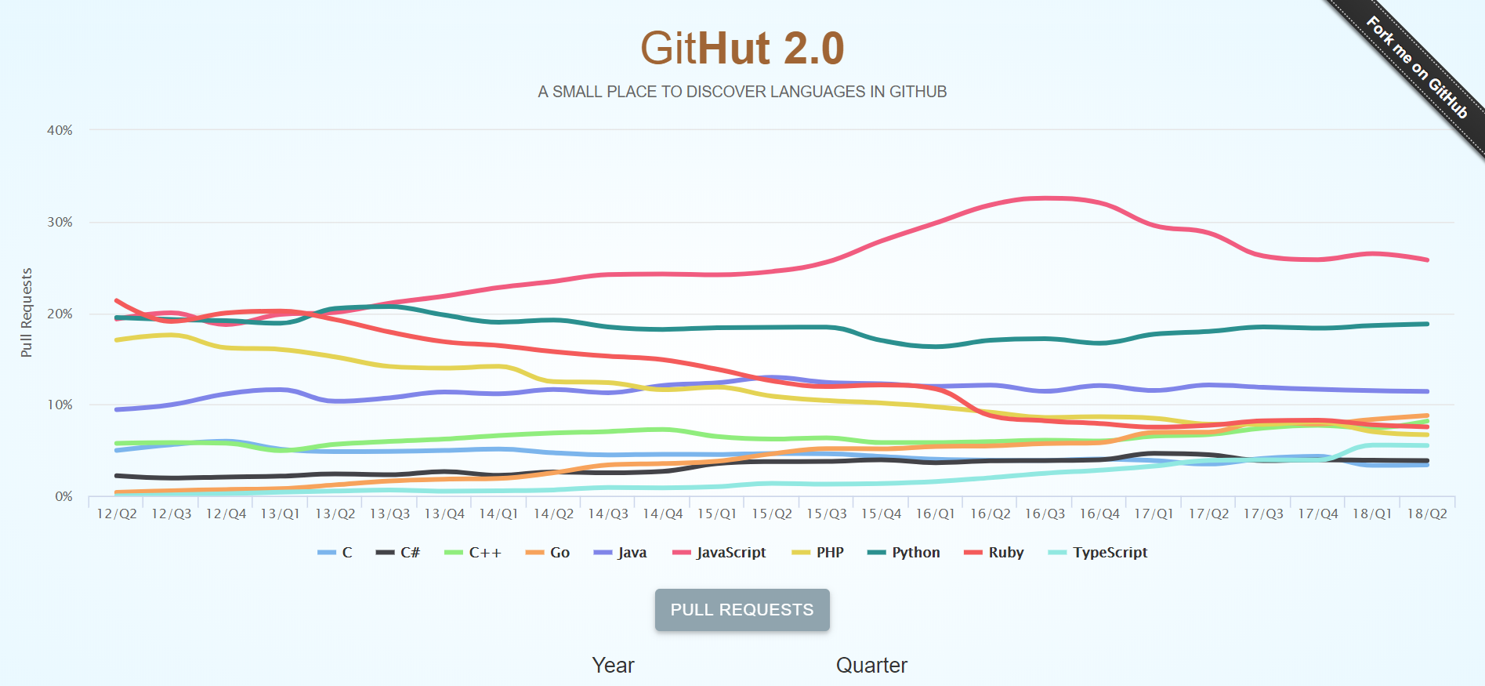
Maturity

Slide 20

Technical Constraints & Feature Richness

Slide 21
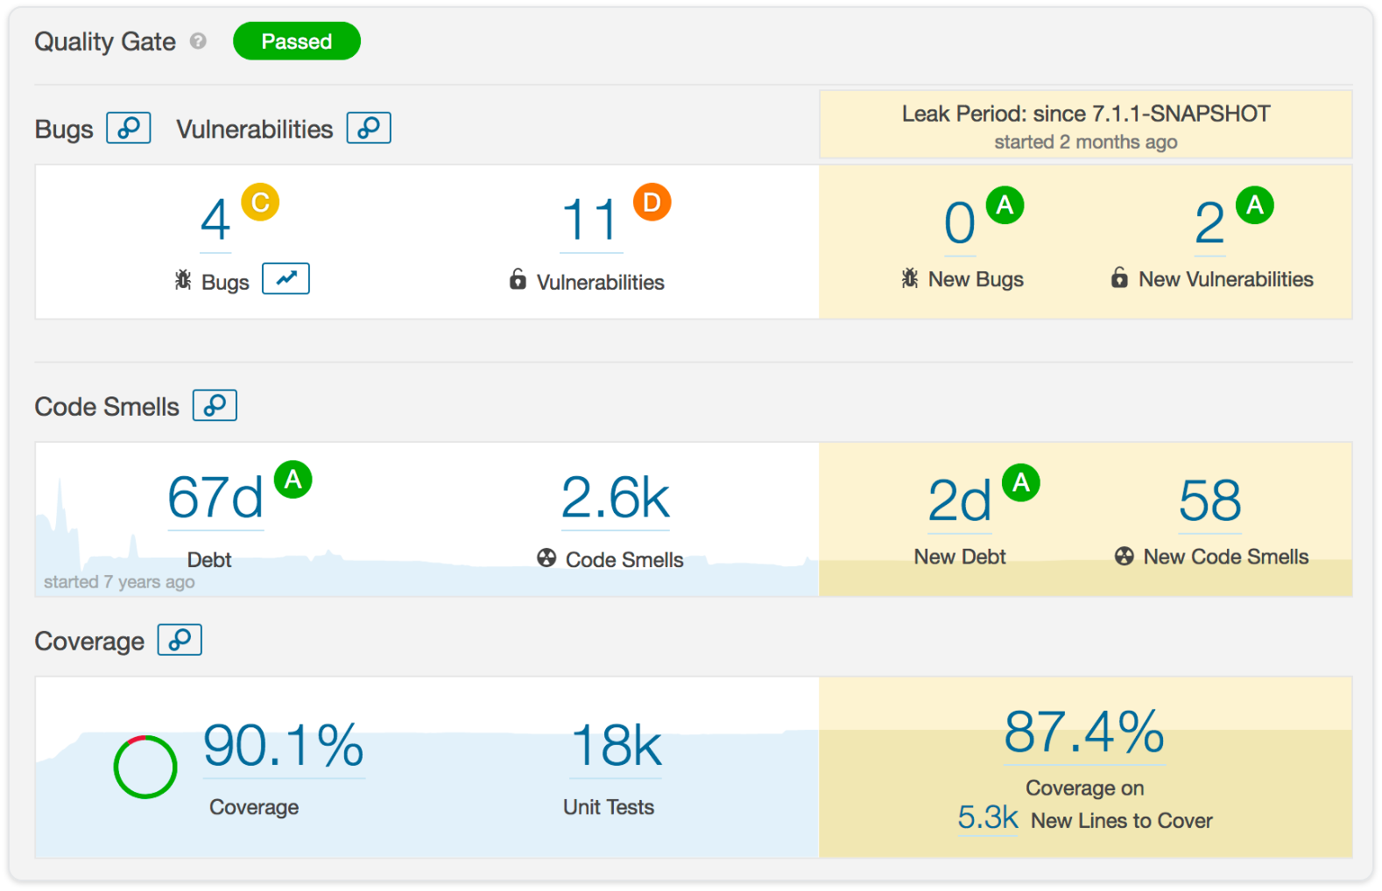
Design & Simplicity & API & Stability

Slide 22
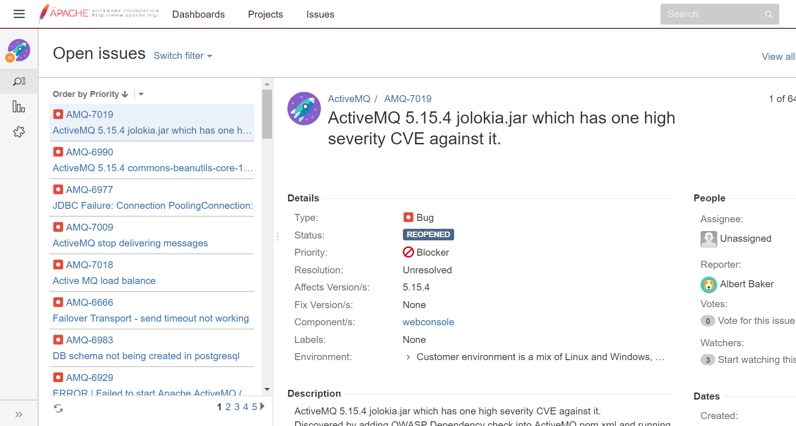
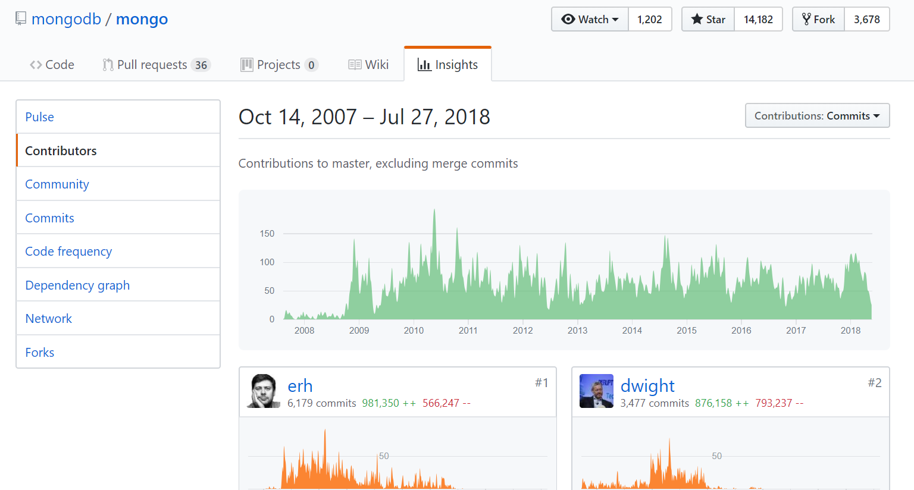
Stability

Slide 23
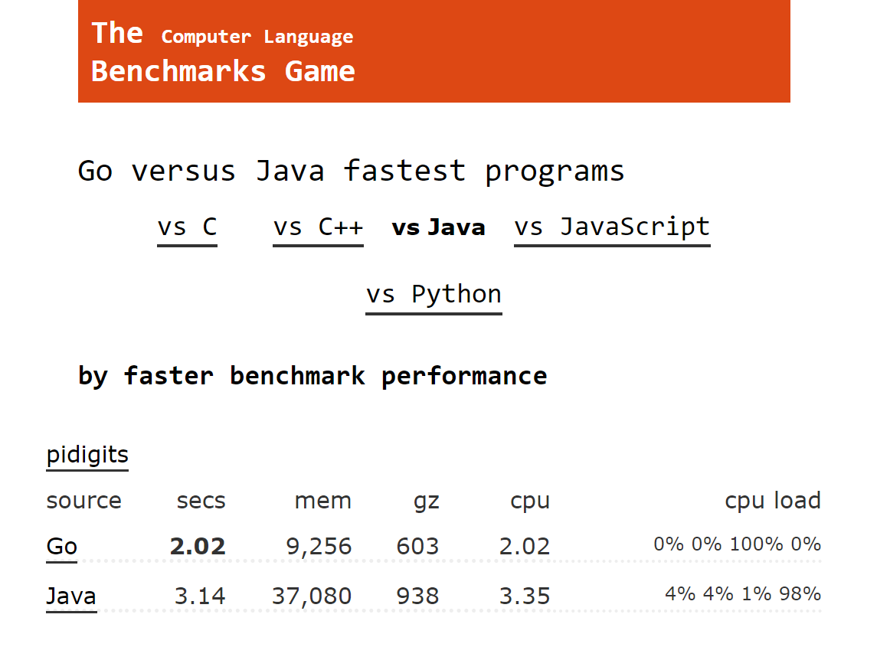
Performance

Slide 24
… but this is about HOW
Notes:
POLL!!!

Slide 25
How do you make technical decisions? (32)
I'm using past project experiences - 63%
I'm using framework defaults - 9%
It's a well defined process - 3%
It's totally ad-hoc - 3%
It's architect / tech-lead 's call - 13%
"Stackoverflow it" and just include it in my PR - 3%
other (prefer not to tell) - 6%

Slide 26
Breadth-First

Slide 27

LEAN

Slide 28
LEAN
SET-BASED DESIGN
LAST RESPONSIBLE MOMENT
Notes:
Set-based design: “Deliver as fast as possible”
Last responsible moment: “Decide as late as possible”

Slide 29
Set-Based Design
Get me the …. (fastest, cheapest, easiest)
Branch
Combine

Slide 30
Set-Based Design
CHEAPEST
FASTEST
!
EASIEST
Notes:
Get me the …. (fastest, cheapest, easiest)
Branch
Combine
OWN STORY: Workaround & Parallel in the last day of sprint.

Slide 31
Last Responsible Moment
parallel dependencies
interfaces & abstractions
feature toggles
deprecation
Notes:
OWN STORY: 3 DB implementation. Remove deprecated.

Slide 32

MISSING KEY INGREDIENT

Slide 33



Slide 34
Decision Making
Group can be smarter / dumber
Use your intuition
Remember: breadth-first
Be CALM & COLLABORATIVE
Notes:
OWN STORY: 3 DB implementation. Remove deprecated.

Slide 35

Awesome Decision Making Recipe
Get away from computers
Pick 4-7 metrics
Brainstorm alternatives
Collect measures
Rate from 1-5
Disagreement LEAN

Slide 36

$$Σ$$
in

Slide 37
HOW > WHAT
IT’S NOT TECHNICAL

Slide 38
Q & A

Slide 39





Thank You!
Oresztész Margaritisz
@gitaroktato
gitaroktato
gitaroktato
https://www.linkedin.com/in/oresztesz

Slide 40
References
How we decide (book summary)
Choose Boring Technology
Set-based design
How to make technical decisions given very little time?
Stackoverflow Insights
Analyzing code with SonarQube in Docker
Google Trends
Software Engineering Wisdom
Lean Tools: Making Decisions
Lean Tools: Options Thinking
EPAM Quality Attributes and Metrics

